Slide 1
Elton Mayo’s Hawthorne Experiment and It’s Contributions to Management
Presented by :
Ms.P.Premakumari
Assistant Professor
Department of Business Administration
St.Joseph’s College (Autonomous ) Trichy

Slide 2
INTRODUCTION
Elton mayo was born in Australia in 1880
Elton Mayo started his work at Hawthorne in 1924
In 1927, a group of researchers led by Elton Mayo and
Fritz Roethlisberger
The Hawthorne Experiments brought out that the
productivity of the employees
Mayo’s idea was that logical factors were far less
important than emotional

Slide 3
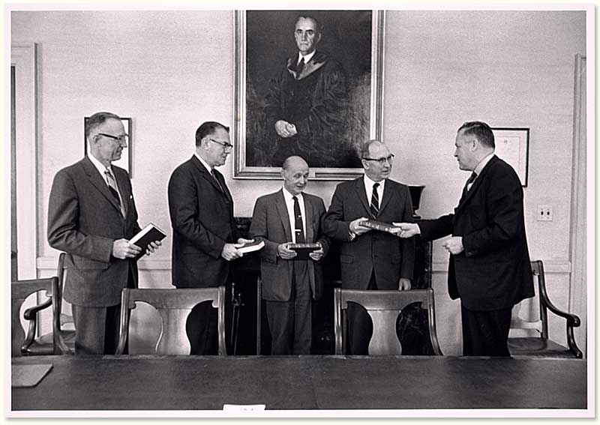
The Hawthorne experiment consists of four parts
1.Illumination Experiment
2.Relay Assembly Test Room Experiment
3.Mass Interview Programme
4.Bank Wiring Test Room Experiment

Slide 4
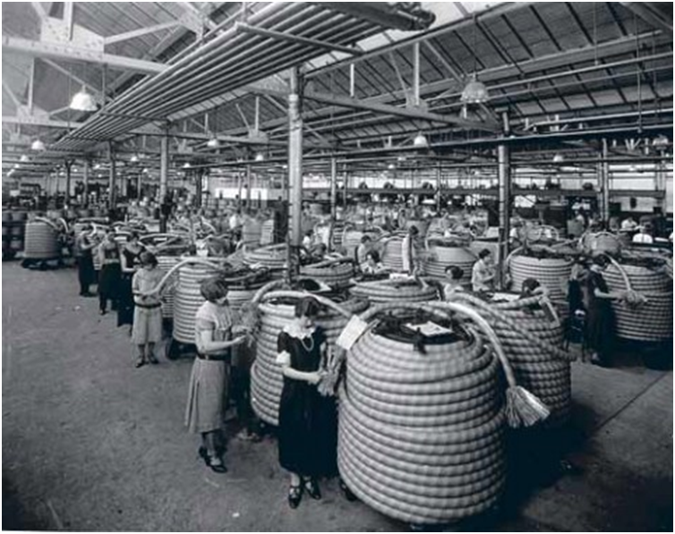
1. Illumination Experiment
This experiment was conducted to establis relationship between output and illumination
The output showed an upward trend even when the illumination was gradually brought down to the normal level
it was concluded that there is no consistent relationship between output of workers and illumination in the factory
There must be some other factor which affected productivity

Slide 5
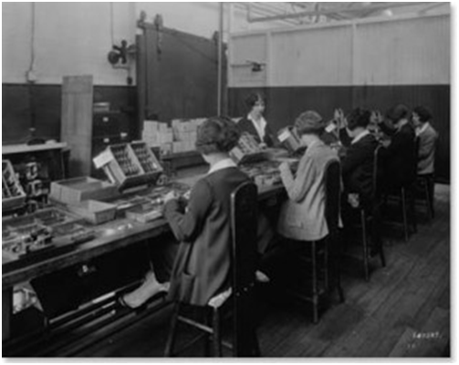
2. Relay Assembly Test Room Experiment
This phase aimed at knowing not only the impact of illumination on production.
In this experiment a small homogeneous work-group of six girls was constituted.
These girls were friendly to each other and were asked to work in a very informal atmosphere under the supervision of a researcher.
Productivity and morale increased considerably
The researchers concluded that socio-psychological factors such as feeling of being important, recognition, attention, participation.

Slide 6
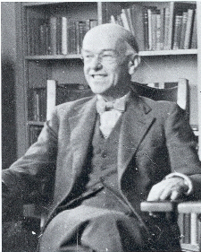
3. Mass Interview Programme
The objective of this programme was to make a systematic study of the employee
The researchers interviewed a large number of workers with regard to their opinions on work
working conditions and supervision Initially
The researchers observed that the replies of the workmen were guarded
The findings confirmed the importance of social factors at work in the total work environment

Slide 7
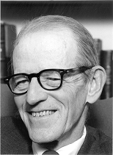
4. Bank Wiring Test Room Experiment
This experiment was conducted by Roethlisberger and Dickson
develop a new method of observation and obtaining
The experiment was conducted to study a group of workers under conditions which were as close as possible to normal
the experiment, the production records of this group were compared with their earlier production records

Slide 8
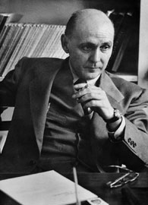
CONCLUSION
As each change was intruduced absenteeeism decreased,
moral increased and less supervision was required
Sense of belongingness,self displine,sincerity increases
Group psychology plays an important role in any business organization. We must therefore rely more on informal group effort
Productivity is linked with employee satisfaction in any business organization
A business organization is basically a social system

Slide 9
Cont…..
A business organization is basically a social system. It is not just a techno-economic system
The employer can be motivated by psychological and social wants
Management must learn to develop co-operative attitudes and not rely merely on command
Participation becomes an important instrument in human relations movement

Slide 10


Slide 11
REFERENCE
https://www.google.co.in/webhp?sourceid=chrome-instant&ion=1&espv=2&es_th=1&ie=UTF-8#q=elton%20mayo%20contribution%20four%20phase%20
http://www.telelavoro.rassegna.it/fad/socorg03/l4/Elton%20Mayo-Hawthorne.htm

